Slide 1


"Empowering pedestrians through voice-guided navigation"

Slide 2



PROBLEM STATEMENT
"Urban pedestrians face safety challenges, especially those with impaired or limited mobility due to lack of accessible safe crossing apps."
Team:
Tech-Titans
Team Lead:
Salma Tahreem
Theme:
Computer Vision
Institute: Stanley College of Engineering & Technology for Women's

Slide 3
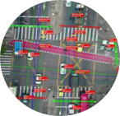


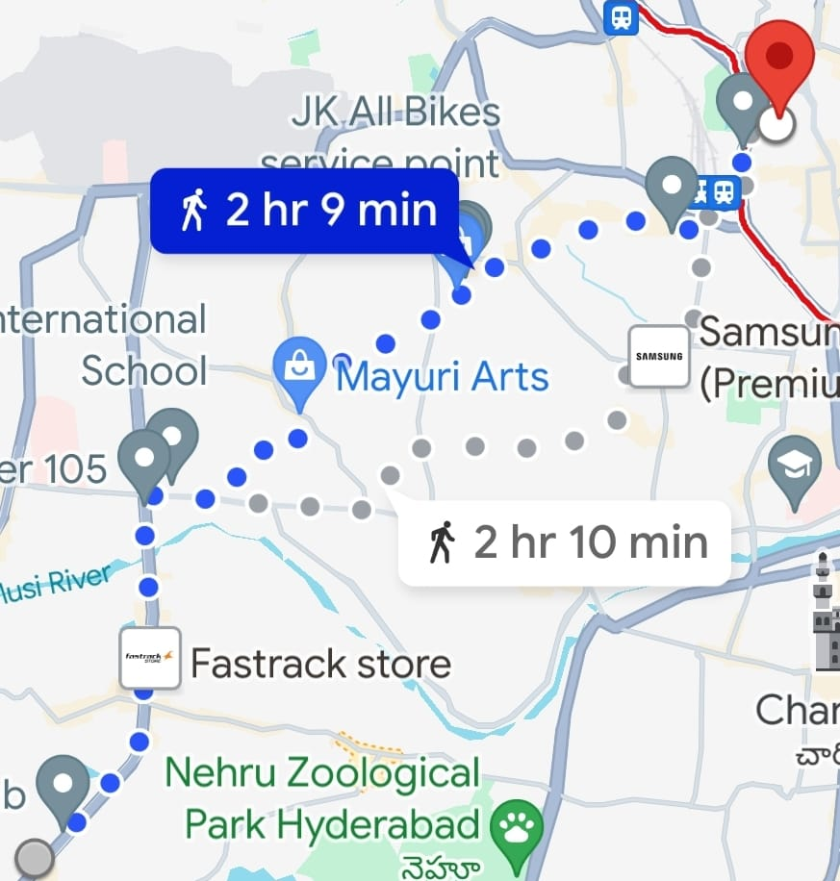
Description of idea
Mobile application providing real-time voice instructions for pedestrians.
Specifically designed for users with visual impairments, limited mobility.
Utilizes GPS technology to detect user location and calculate the safest routes.
Customizable features.
Enhances pedestrian safety and independence in urban landscapes.
REAL-TIME TRAFFIC ANALYSIS
VOICE RECOGNITION
PEDESTRIAN SAFETY
INTERACTIVE MAPS

Slide 4


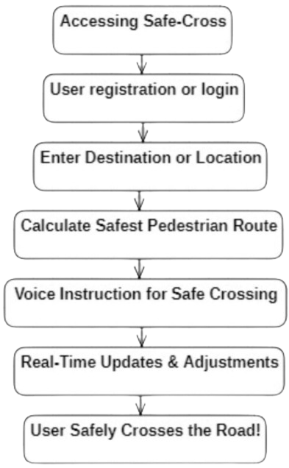
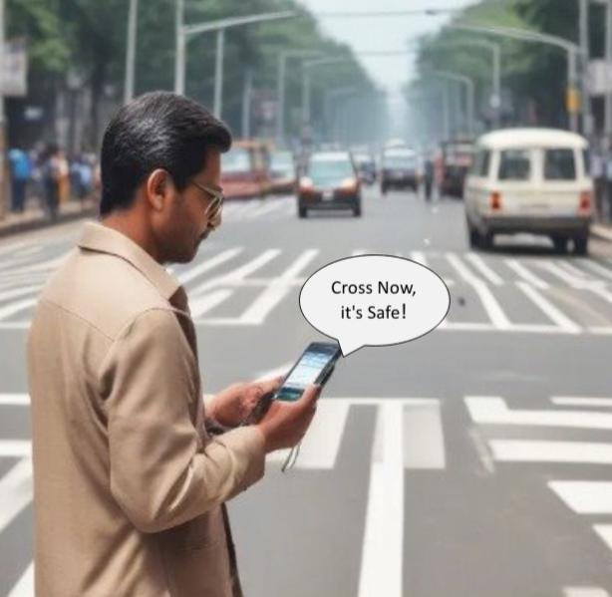
TECHNOLOGY STACK & PROCESS FLOW
MOBILE
DEVELOPMENT
JAVA FOR ANDROID, OBJECTIVE-C FOR IOS
LOCATION SERVICES
GOOGLE MAPS API, MAPBOX
VOICE RECOGNITION
GOOGLE CLOUD SPEECH-TO-TEXT, TEXT-TO-SPEECH API
REAL TIME DATA
GOOGLE MAPS API, GPS TECHNOLOGY

Slide 5
User-friendly interface with voice navigation
Community engagement for feedback and reporting
Real-time traffic updates and pedestrian-focused routing
Customizable preferences and accessibility features
Utilize GPS technology to detect user location and calculate the safest routes
THE
SOLUTION
Integration with public transportation systems
Prioritize navigation routes optimized for safer pedestrian crossings, considering factors like crosswalks, traffic signals, and pedestrian-friendly paths
Ensure scalability and reliability through robust backend infrastructure and continuous monitoring

Slide 6
THE
1.User Research:
Conducting comprehensive user research to understand the specific needs and challenges.
2. Define Requirements:
Clearly defining the requirements and features of the application to provides valuable solutions.
3. Prototype Design:
Creating the prototype of the application to visualize its layout, navigation flow and key features.
4. Technology Selection:
Choosing the appropriate technology stack required.
EIGHT
STEP
APPROACH

Slide 7
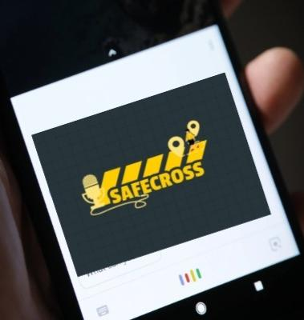
5.Development:
Adding functionalities like GPS-based location detection, route planning and voice guidance then testing them thoroughly.
6.Real-time Integration:
Integrating APIs for real-time traffic updates, pedestrian signals to provide accurate and up-to-date information to users.
7.Launch & Deployment:
Launching the application by optimizing performance, ensuring security measures and complying with app store for public access.
8.Improvements:
Monitor user feedback and app performance post-launch to identify areas for improvement.

Slide 8
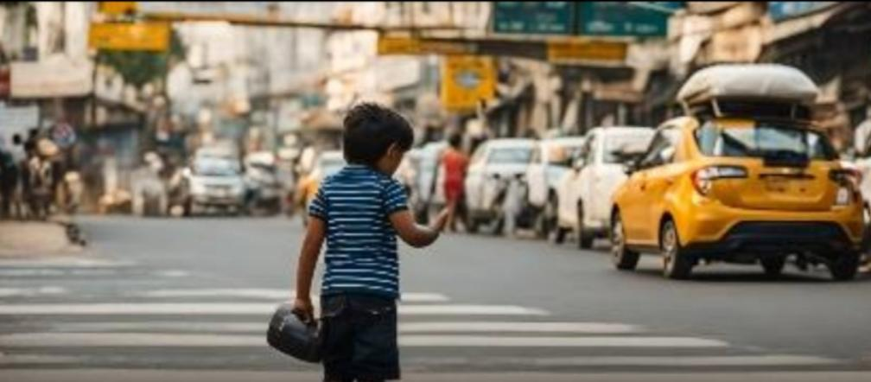
THANK YOU!
"LET'S PAVE THE WAY FOR SAFER ROAD CROSSING!"
Team Leader: Salma Tahreem Branch: BE | Stream: CSE | Year: III
Team Member 1: Shaik Teheseen Mehek Branch: BE | Stream: CSE | Year: III
Team Member 2: Seyda Muneeza Kauser Branch: BE | Stream: CSE | Year: III

